Slide 1
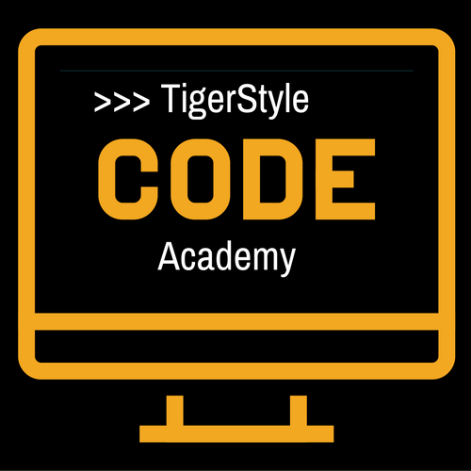
Python web scraping Tutorial - 6
6 – BeautifulSoup4 & find() and findAll()
TigerStyle Code Academy

Slide 2
Find() and findAll() functions
find(tag, attributes, recursive, text, keywords)
findAll(tag, attributes, recursive, text, limit, keywords)
Tags: .findAll({“h1”, “h2”, “h3”, “h4”, “h5”, “h6”})
Attributes: .findAll(“span”, {“class”:{“green”, “red}})
Recursive: Boolean
Text: nameList = bsObj.findAll(text=“the prince”) print(len(nameList)) >>> “7”
Limit: = findAll() with a limit of 1
Keyword: allText = bsObj.findAll(id=“title”, class=“text”)

Slide 3
Keyword argument
bsObj.findAll(id=“text) bsObj.findAll(“”, {“id”:”text”})
bsObj.findAll(class=“green”) bsObj.findAll(class_=“green”) bsObj.findAll(“”, {“class”:”green”})

